Slide 1

Neuroscience of Addiction
Sangeeta Das Bhattacharya MD, MPH
IIT Kharagpur
Spring 2018

Slide 2

Nicomachean Ethics
340 BC Aristotle
Hedonic Happiness
-a positive mental high
Eudaimonic Happiness
“Happiness is the meaning and purpose of life, the whole aim and end of human existence”
Aristotle

Slide 3
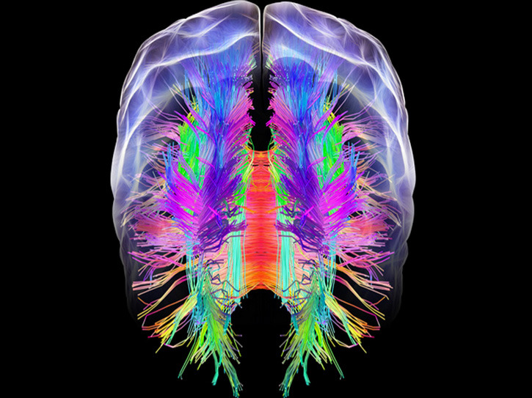
Drugs of Abuse
What do they affect:
Motivation Circuits
Pleasure Pathways

Slide 4
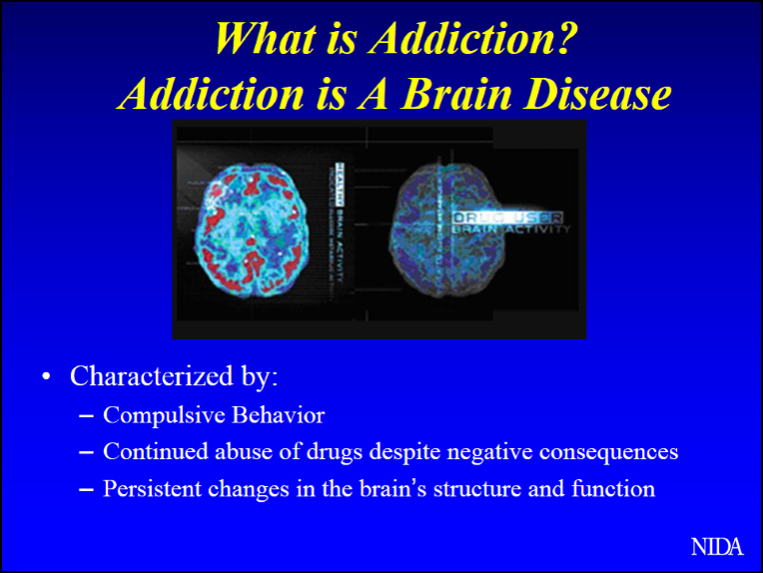

Slide 5
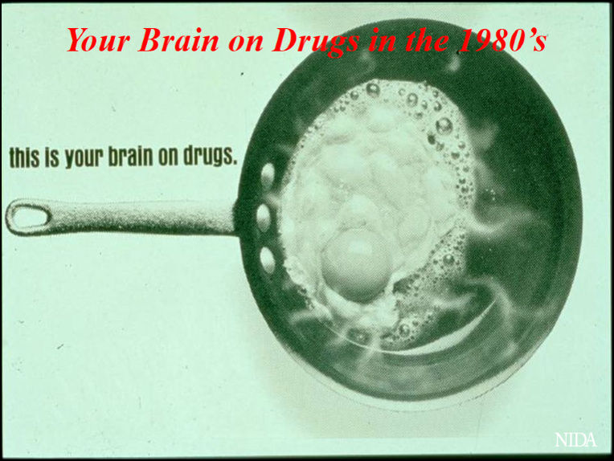
1980’s

Slide 6
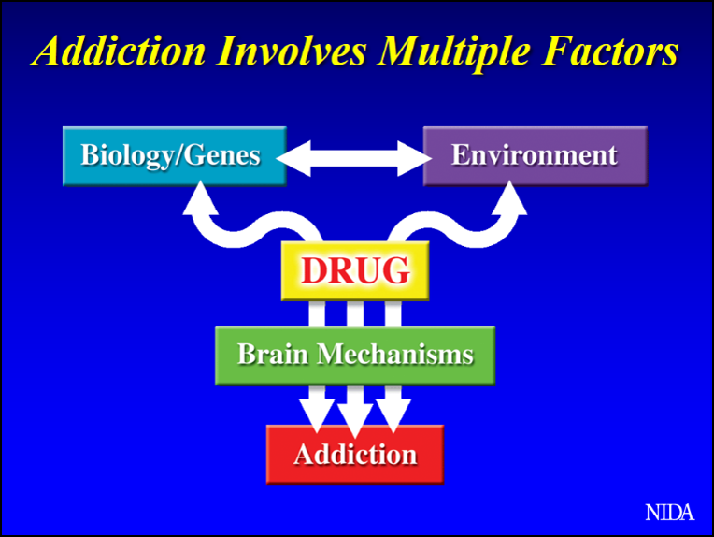
Addiction
No single factor determines risk of addiction
Anybody can become addicted

Slide 7
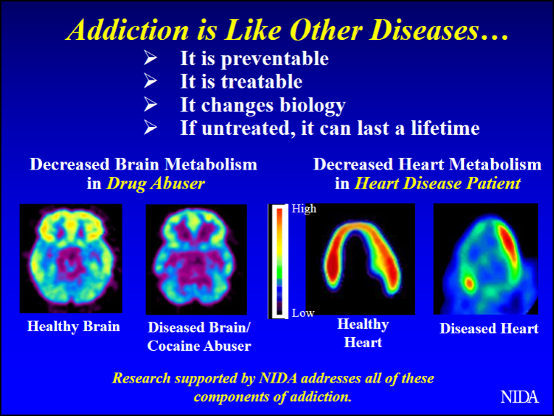
Functional Brain Imaging
Glucose metabolism in brain and heart
Healthy areas red and yellow
Frontal cortex which is involved in judgement and decision making affected in addiction

Slide 8
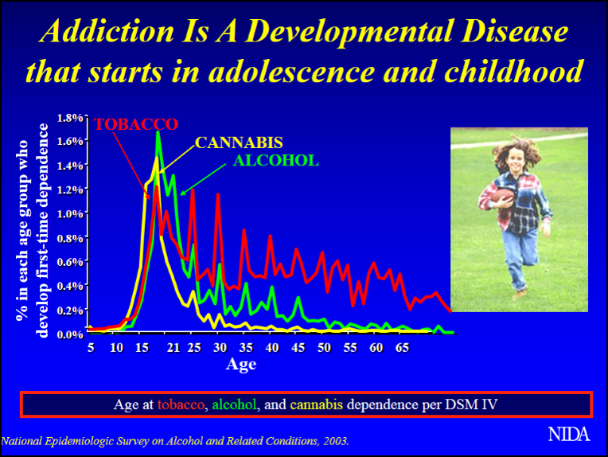
Age at diagnosis of dependence
Tobacco
Cannabis
Alcohol
age at diagnosis of drug dependence is in adolescence and early adulthood

Slide 9
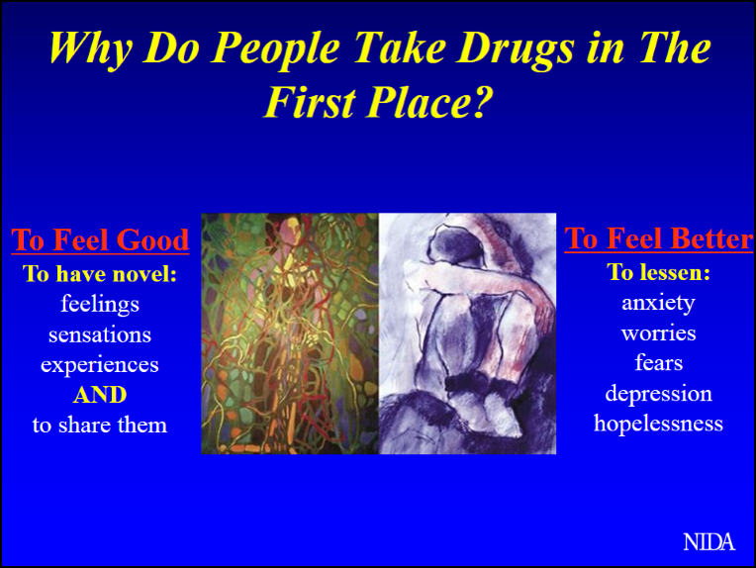
Why is this occurring more in adolescents and young adults?

Slide 10
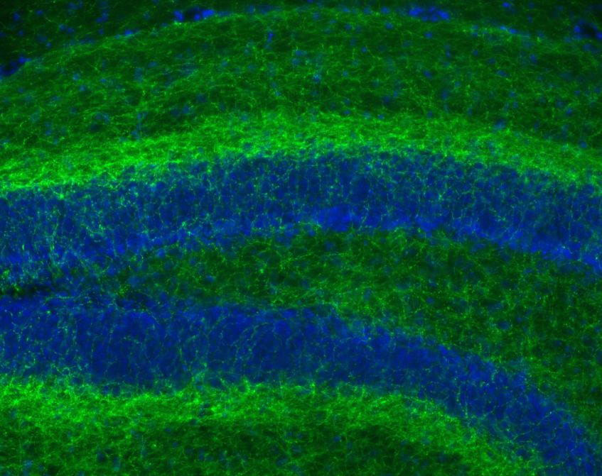
Brain Networks
Network of Neurons
Endocannabinoid System
Receptors
Neurotransmitters
Enzymes
Crick, Frances NIH Director’s blog
Cannabinoid receptors in the brain

Slide 11
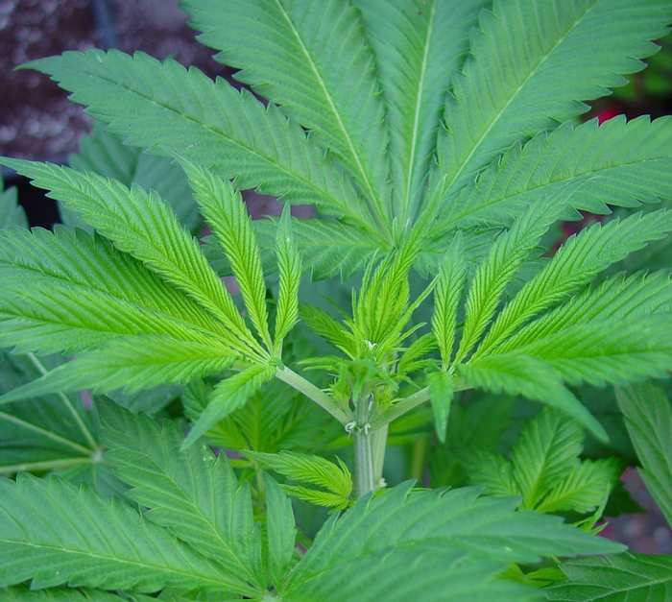
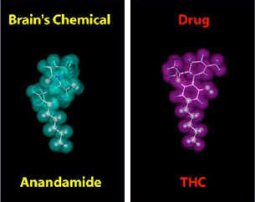
Look alike
Cannabinoids
Structural similarity allows THC to be recognized by neurons and alter normal brain messages.
Anandamide regulates pain, appetite, memory, mood

Slide 12
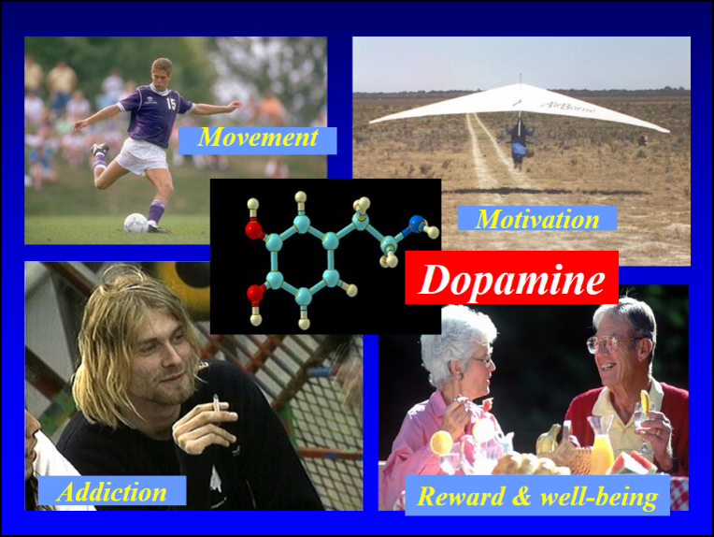
Dopamine
Nearly all drugs of abuse increase dopamine in the motivation and pleasure pathways
Alters normal communication between neurons

Slide 13
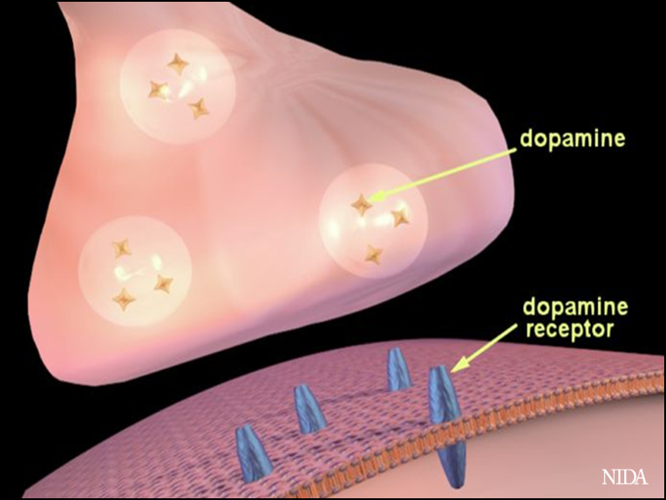
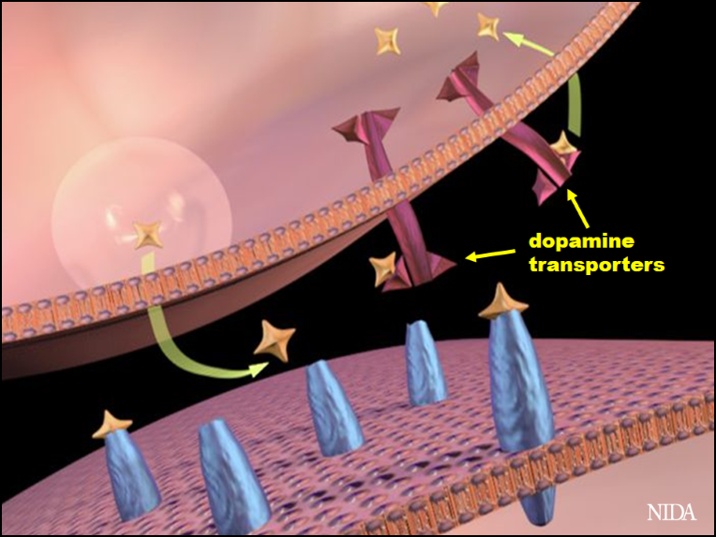
Dopamine
Dopamine Regulation in Synaptic Space is tightly regulated

Slide 14
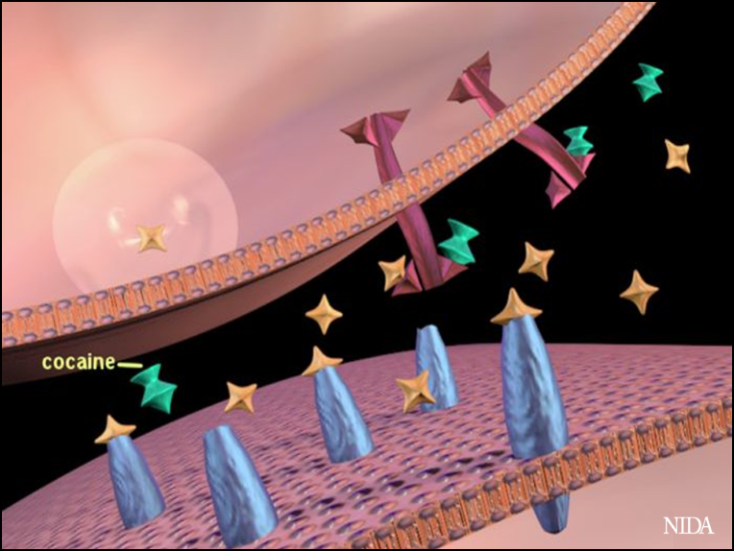
Dopamine Regulation
Example
Cocaine interferes with Dopamine transporter
Dopamine remains in the synaptic space

Slide 15
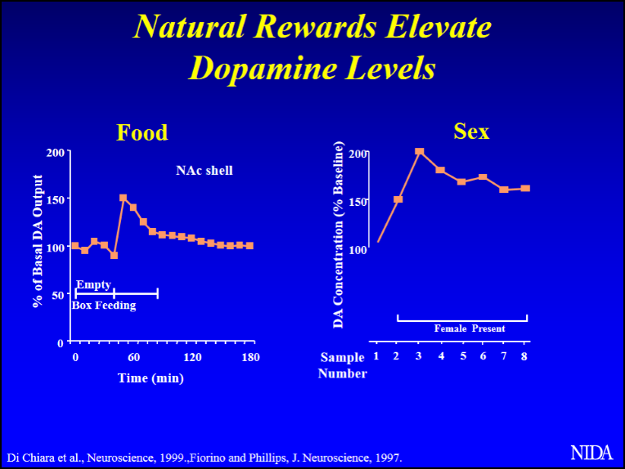
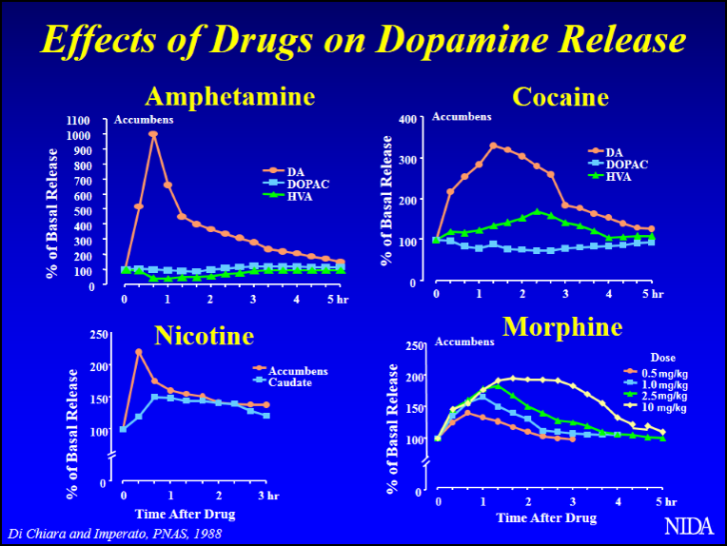
Dopamine Release
Natural
Impact of Drugs

Slide 16
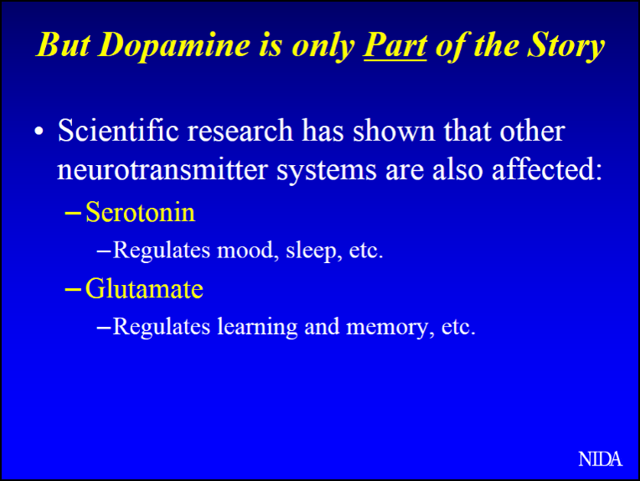
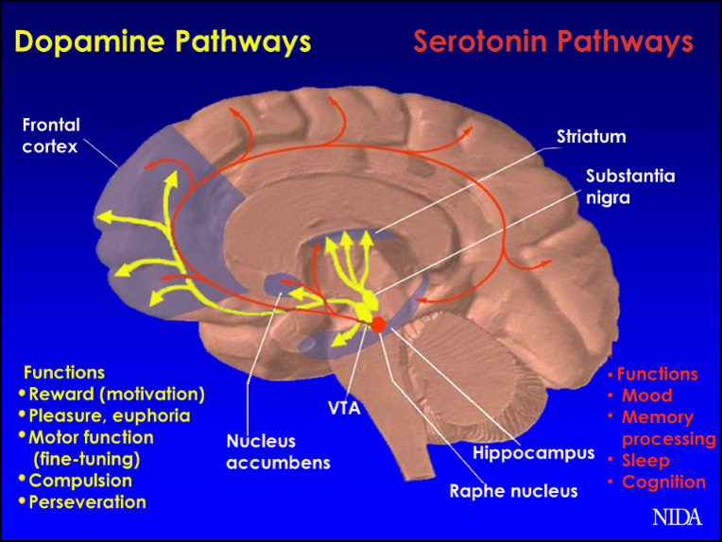
Other Pathways
Serotonin
Glutamate

Slide 17
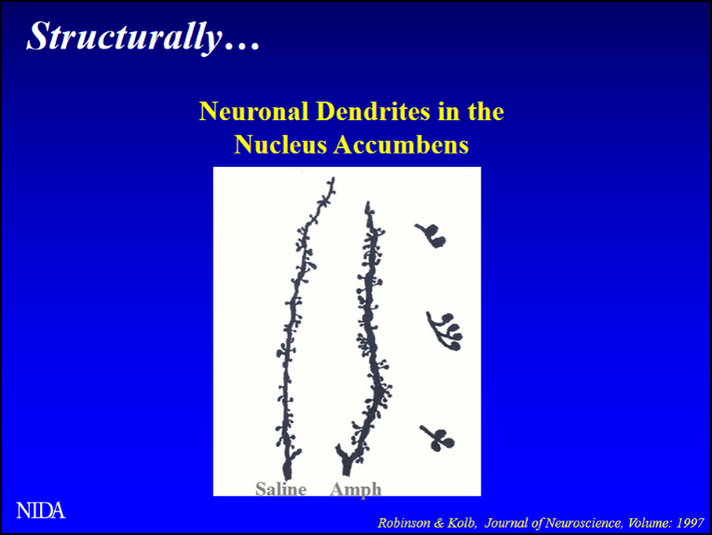
Structural Changes
Prolonged Exposure to Stimulants
Dendrites of dopamine neurons in amphetamine exposed animals have more dendritic spine

Slide 18
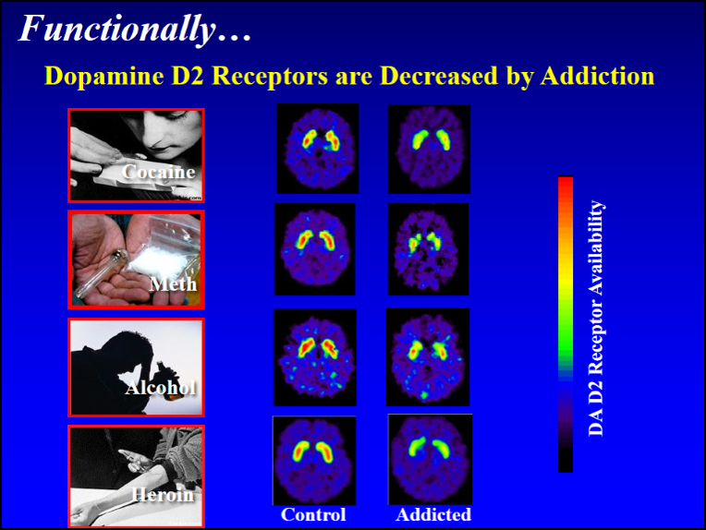
Functional Changes
PET images show lower levels of D2 receptors in brains affected by addiction

Slide 19
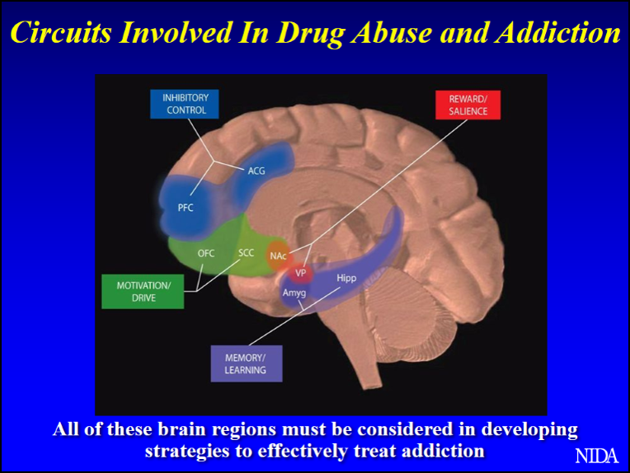
Brain Circuits Affected by Drugs
Reward
Learning, Memory
Motivation, drive
Inhibatory Control

Slide 20
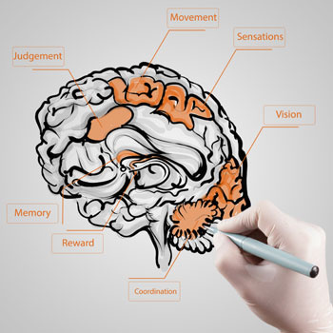
Endocannabinoid System
Function
Modulates neurobiological pathways
Keeps activity at the cellular level in balance
Systems
Reward
Memory
Cognition
Stress
Pain

Slide 21
Look alike
Cannabinoids
Structural similarity allows THC to be recognized by neurons and alter normal brain messages.
Anandamide regulates pain, appetite, memory, mood

Slide 22
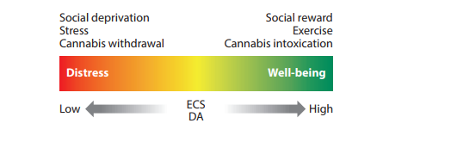

Slide 23
How old is Human Cannabis Use?

Slide 24

Assyrians
Assyrians
Ganzi-gun-nu- the drug that takes away the mind
Second millennia BC

Slide 25
The Drug has changed…

Slide 26
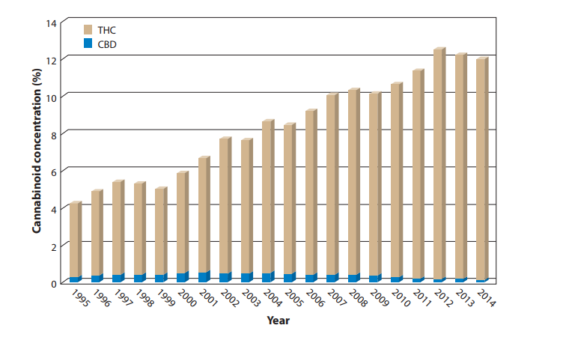

Slide 27
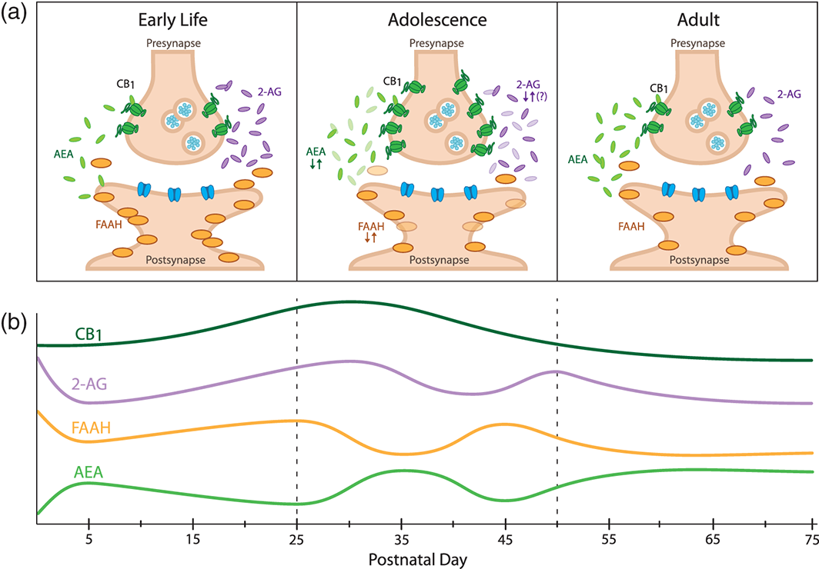
Adolescent and Young Adult THC Exposure Developmental regulation of fear learning and anxiety behavior by endocannabinoids
Reduced stress coping
Increased anhedonia
Increased anxiety
Impaired memory and learning
Lowering of IQ
Genes, Brain and Behavior Volume 15, Issue 1, pages 108-124, 5 NOV 2015 DOI: 10.1111/gbb.12253 http://onlinelibrary.wiley.com/doi/10.1111/gbb.12253/full#gbb12253-fig-0003
Notes:
Corticolimbic endocannabinoid (eCB) signaling changes dynamically across rodent development. (a) Distinct eCB signaling profiles in early life, adolescence and adulthood. Components of the eCB system are represented schematically within a synapse (adapted from(Long et al. ). (b) Developmental trajectories of the components of the eCB system. CB₁ receptor expression peaks with the onset of adolescence. 2‐AG is highest around birth and may fluctuate throughout adolescence. AEA gradually increases during early life and fluctuates during adolescence. FAAH activity fluctuates in reciprocal fashion to AEA during adolescence (based on data from Berrendero et al. ; Ellgren et al. ; Fernandez‐Ruiz et al. ; Heng et al. ; Lee et al. ; Rodriguez de Fonseca et al. ; Rubino et al. ; Wenger et al. ).
IF THIS IMAGE HAS BEEN PROVIDED BY OR IS OWNED BY A THIRD PARTY, AS INDICATED IN THE CAPTION LINE, THEN FURTHER PERMISSION MAY BE NEEDED BEFORE ANY FURTHER USE. PLEASE CONTACT WILEY'S PERMISSIONS DEPARTMENT ON PERMISSIONS@WILEY.COM OR USE THE RIGHTSLINK SERVICE BY CLICKING ON THE 'REQUEST PERMISSIONS' LINK ACCOMPANYING THIS ARTICLE. WILEY OR AUTHOR OWNED IMAGES MAY BE USED FOR NON-COMMERCIAL PURPOSES, SUBJECT TO PROPER CITATION OF THE ARTICLE, AUTHOR, AND PUBLISHER.

Slide 28
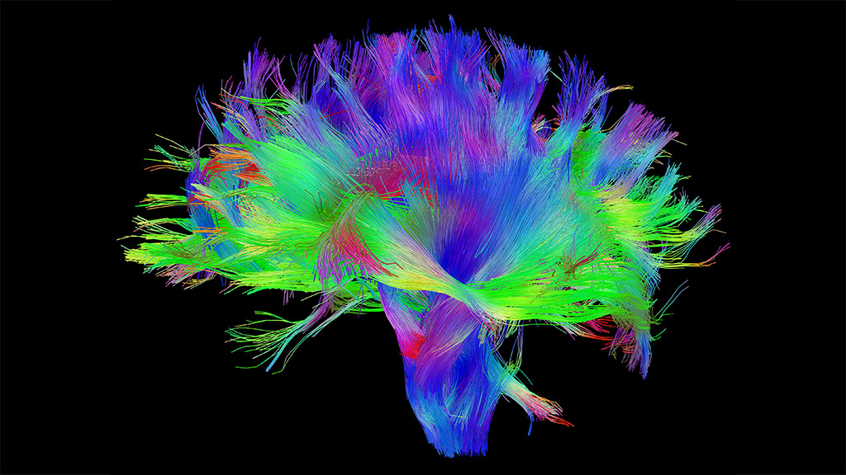
Connections

Slide 29
Synaptic pruning
Connections that are not being used are eliminated to increase efficiency of neural transmission

Slide 30
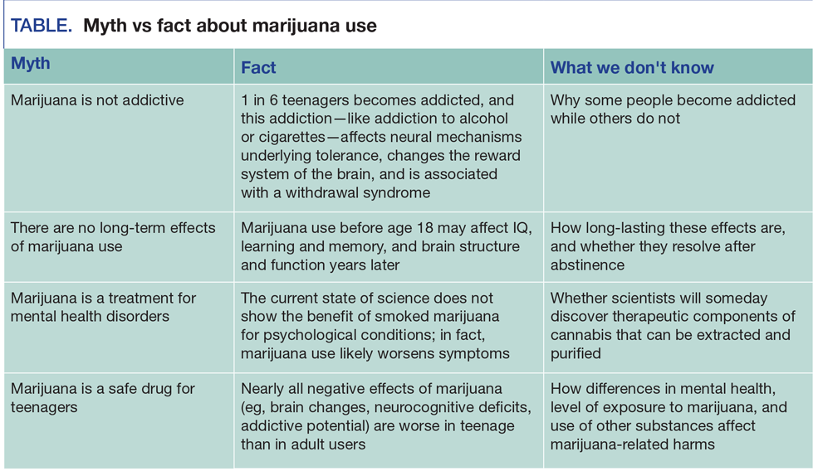

Slide 31
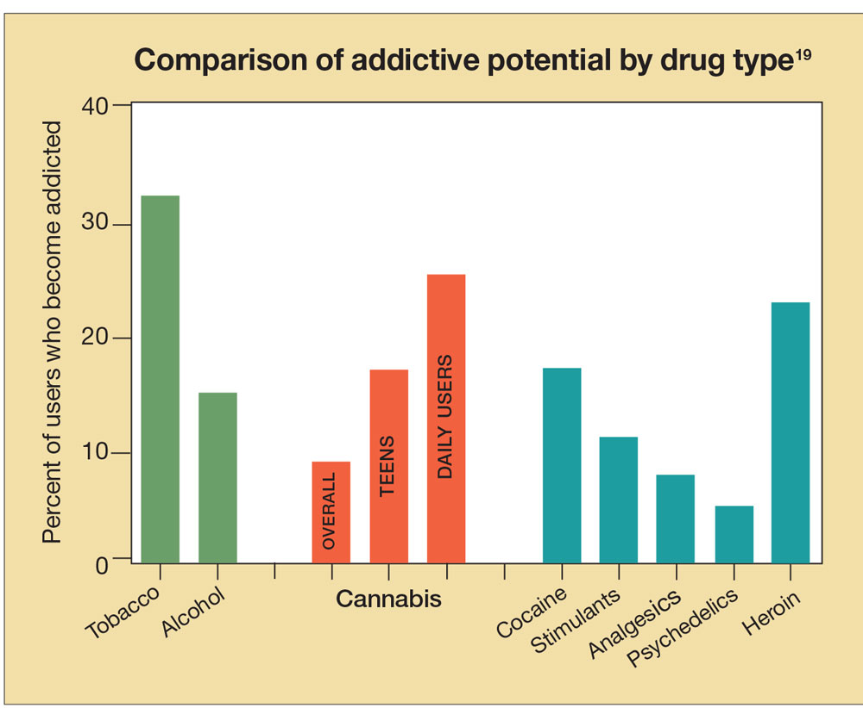

Slide 32
Evidence from Imaging studies
decreased volume in prefrontal cortex
Sulci thinning in frontal, parietal and temporal lobes
Decreased hippocampal volume
Poorer white matter integrity
Cannabis impacts brain-wiring in adolescents and young adults

Slide 33
Impact of Cannabis on Cognition
Evidence from longitudinal studies
8 point drop in IQ in adult cannabis users who started before the age of 18
Problems with verbal memory
Impaired learning and recall
Executive functioning (planning)
Processing speed
Memory
Attention
Focus
Planning

Slide 34
Impact of Long Term Mental Health
Link between cannabis use and psychotic behaviors
Causal link in accelerating schizophrenia
Increased anxiety disorders and dclinical depression
Evidence from 50,000 adults across 17 countries that show 50% increase risk of episode of clinical depression after age 17

